Slide 1
BUILT-IN FUNCTIONS
Instructor:

Slide 2

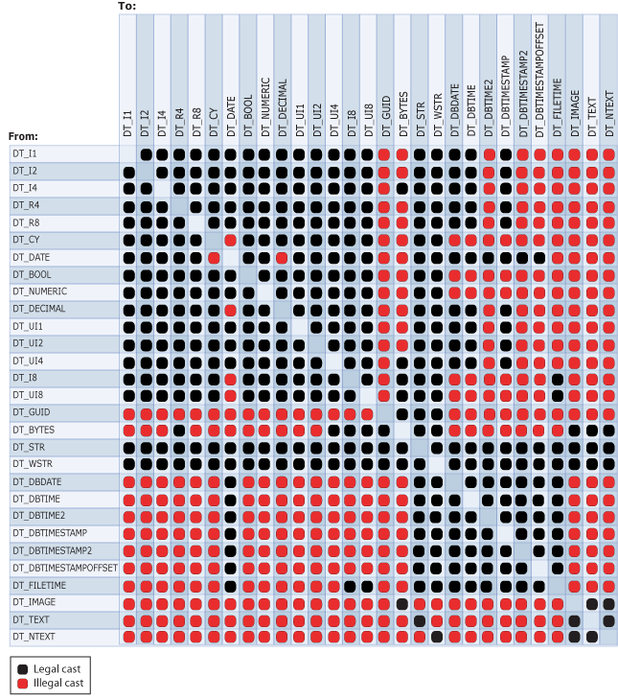
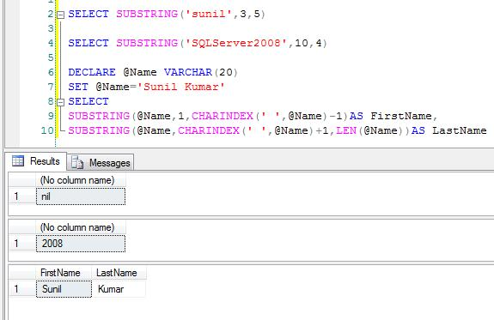
Learning Goals
By the end of this lecture students should be able to:
Understand about the built-in functions in SQL Server
Recognize how to use built-in functions to perform operations on data

Slide 3
Table of contents
Conversion Functions
Date and Time Functions
String Functions

Slide 4
CONVERSION FUNCTIONS
Section1

Slide 5
CAST Function
Converts an expression of one data type to another in SQL Server 2008 R2.
The Cast() function is used to convert a data type variable or data from one data type to another data type.
The Cast() function provides a data type to a dynamic parameter (?) or a NULL value.
Syntax for CAST:
CAST ( expression AS data_type [ ( length ) ] )

Slide 6
CONVERT Function (1/3)
When you convert expressions from one type to another, in many cases there will be a need within a stored procedure or other routine to convert data from a datetime type to a varchar type.
The Convert function is used for such things. The CONVERT() function can be used to display date/time data in various formats
Syntax for CONVERT:
CONVERT ( data_type [ ( length ) ] , expression [ , style ] )
Style (0 hoặc 100): mon dd yyyy hh:miAM (or PM)

Slide 7
CONVERT Function (2/3)
Without century (yy) | With century (yyyy) | Standard | Input/Output
- | 0 or 100 | Default | mon dd yyyy hh:miAM (or PM)
1 | 101 | U.S. | mm/dd/yyyy
2 | 102 | ANSI | yy.mm.dd
3 | 103 | British/French | dd/mm/yyyy
4 | 104 | German | dd.mm.yy
5 | 105 | Italian | dd-mm-yy
6 | 106 | - | dd mon yy
7 | 107 | - | Mon dd, yy
8 | 108 | - | hh:mi:ss
- | 9 or 109 | Default + milliseconds | mon dd yyyy hh:mi:ss:mmmAM (or PM)
10 | 110 | USA | mm-dd-yy
11 | 111 | JAPAN | yy/mm/dd

Slide 8
CONVERT Function (3/3)
Without century (yy) | With century (yyyy) | Standard | Input/Output
12 | 112 | ISO | yymmdd Yyyymmdd
- | 13 or 113 | Europe default + milliseconds | dd mon yyyy hh:mi:ss:mmm(24h)
14 | 114 | - | hh:mi:ss:mmm(24h)
- | 20 or 120 | ODBC canonical | yyyy-mm-dd hh:mi:ss(24h)
- | 21 or 121 | ODBC canonical (with milliseconds) | yyyy-mm-dd hh:mi:ss.mmm(24h)
- | 126 | ISO8601 | yyyy-mm-ddThh:mi:ss.mmm (no spaces)
- | 127 | ISO8601 with time zone Z | yyyy-mm-ddThh:mi:ss.mmmZ (no spaces)
- | 130 | Hijri | dd mon yyyy hh:mi:ss:mmmAM
- | 131 | Hijri | dd/mm/yy hh:mi:ss:mmmAM

Slide 9
DATE AND TIME FUNCTIONS
Section2

Slide 10
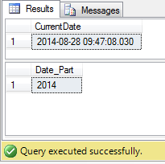
GETDATE() & DATEPART() Function (1/2)
The GETDATE() function returns the current date and time from the SQL Server.
The DATEPART() function is used to return a single part of a date/time, such as year, month, day, hour, minute, etc.
Ex : SELECT GETDATE()
SELECT DATEPART(YYYY, GETDATE())
Result :
Syntax:
GETDATE()
DATEPART(datepart, date)

Slide 11
GETDATE() & DATEPART Function (2/2)
datepart | Abbreviation
year | yy, yyyy
quarter | qq, q
month | mm, m
dayofyear | dy, y
day | dd, d
week | wk, ww
weekday | dw, w
hour | hh
minute | mi, n
second | ss, s
millisecond | ms
microsecond | mcs
nanosecond | ns

Slide 12
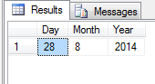
DAY, MONTH,YEAR Function
Returns an integer representing the day/month/year (day of the month) of the specified date.
Ex : SELECT DAY(GETDATE()) AS [Day],
MONTH(GETDATE()) AS [Month],
YEAR(GETDATE()) AS [Year]
Result :
Syntax:
DAY(date)
MONTH(date)
YEAR(date)

Slide 13
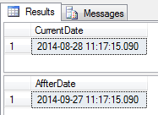
DATEADD Function
The DATEADD() function adds or subtracts a specified time interval from a date.
Ex : DECLARE @dt datetime
SET @dt = GETDATE()
SELECT @dt AS CurrentDate
SELECT DATEADD(day, 30, @dt) AS AffterDate
Result :
Syntax:
DATEADD(datepart,number,date)

Slide 14
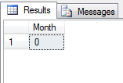
DATEDIFF Function
The DATEDIFF() function returns the time between two dates.
Ex:
DECLARE @date1 DATETIME
DECLARE @date2 DATETIME
SET @date1= '2012-04-07 20:12:22.013'
SET @date2= '2014-02-27 22:14:10.013'
SELECT DATEDIFF(month, @date1, @date2) AS 'Month'
Result:
Syntax:
DATEDIFF (datepart,startdate,enddate)

Slide 15
STRING FUNCTIONS
Section3

Slide 16
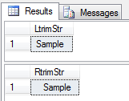
RTRIM, LTRIM Function
LTRIM Removes all white spaces from the beginning of the string.
Ex : SELECT LTRIM(' Sample ');
SELECT RTRIM(' Sample ');
Result :
Syntax:
LTRIM (str)
RTRIM (str)

Slide 17
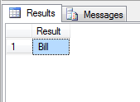
SUBSTRING Function
The Substring function in SQL is used to return a portion of string. This function is called differently in different databases:
Ex : SELECT SUBSTRING('Bill Gates', 0 ,5) As Result
Result :
Syntax:
SUBSTRING(str, position, length)

Slide 18
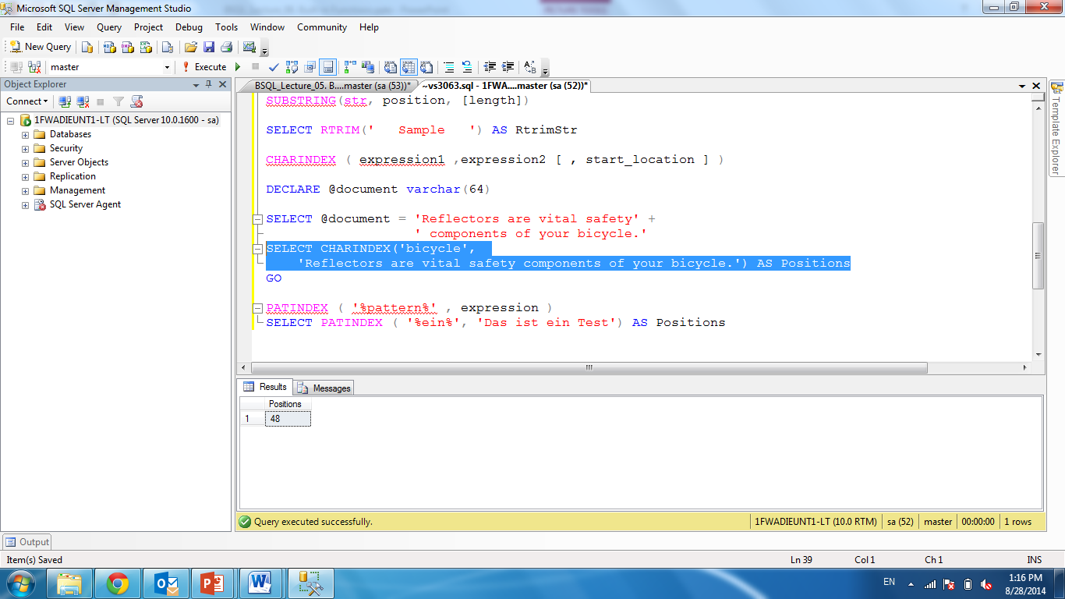
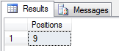
LEN, CHARINDEX, PATINDEX Function
The CHARINDEX and PATINDEX functions return the starting position of a pattern you specify.
PATINDEX can use wildcard characters, but CHARINDEX cannot
Ex : SELECT CHARINDEX('bicycle',
'Reflectors are vital safety components of your bicycle.') AS Positions
SELECT PATINDEX ( '%ein%', 'Das ist ein Test') AS Positions
Result:
Syntax: LEN(str)
CHARINDEX ( expression1 ,expression2 [ , start_location ] )
PATINDEX ( '%pattern%' , expression )

Slide 19

Summary
Conversion Functions
CAST, CONVERT Function
Date and Time Functions
GETDATE, DATEPART, DAY, MONTH,YEAR, DATEDD, DATEIFF Function
String Functions
RTRIM, LTRIM, SUBSTRING, LEN, CHARINDEX, PATINDEX
Demo

Slide 20
Thank you
‹#›

